Slide 1
Digital Fundamentals
CHAPTER 6 Functions of Combinational Logic

Slide 2
Chapter Outline
6–1 Half and Full Adders
6–2 Parallel Binary Adders
6–3 Ripple Carry and Look-Ahead Carry Adders
6–4 Comparators
6–5 Decoders
6–6 Encoders
6–7 Code Converters
6–8 Multiplexers (Data Selectors)
6–9 Demultiplexers
6–10 Parity Generators/Checkers
6–11Troubleshooting Applied Logic

Slide 3
Comparators
The basic function of a comparator is to compare the magnitudes of two binary quantities
In its simplest form, a comparator circuit determines whether two numbers are equal.

Slide 4
Comparators
1-Bit Comparator
2-Bit Comparator
4-Bit Comparator

Slide 5
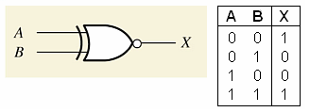
Comparators
1-Bit Comparator - Exclusive NOR
The output is 1 when the inputs are equal

Slide 6
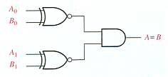
Comparators
2-Bit Comparator
The output is 1 when A₀ = B₀ AND A₁ = B₁

Slide 7
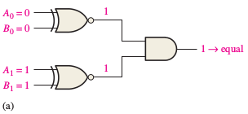
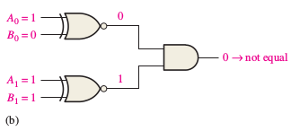
Example 6-5: Comparators
Apply each of the following sets of binary numbers to the comparator inputs in Figure 6–20, and determine the output by following the logic levels through the circuit.
(a) 10 and 10 (b) 11 and 10

Slide 8
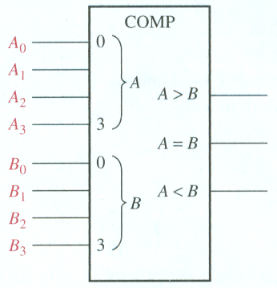
Inequality: Comparators
4-Bit Comparator
One of three outputs will be HIGH:
A greater than B (A > B)
A equal to B (A = B)
A less than B (A < B)
To determine an inequality of binary numbers A and B, you first examine the highest-
order bit in each number. The following conditions are possible:
1. If A3 = 1 and B 3 = 0, number A is greater than number B.
2. If A3 = 0 and B 3 = 1, number A is less than number B.
3. If A3 = B 3 , then you must examine the next lower bit position for an inequality.

Slide 9
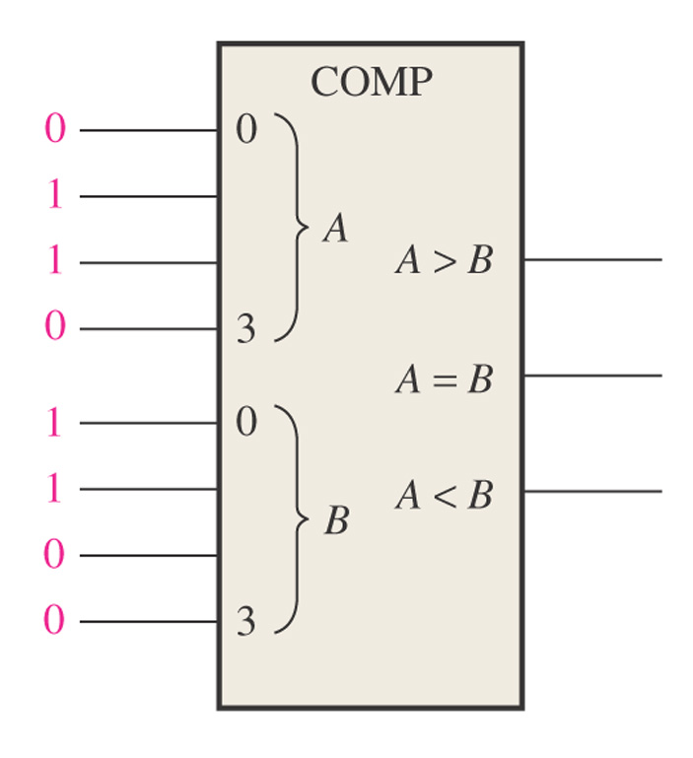
Figure 6–23 What are the outputs for the given inputs?
1
0
0
A B 0110 > 0011 YES 0110 = 0011 NO 0110 < 0011 NO

Slide 10
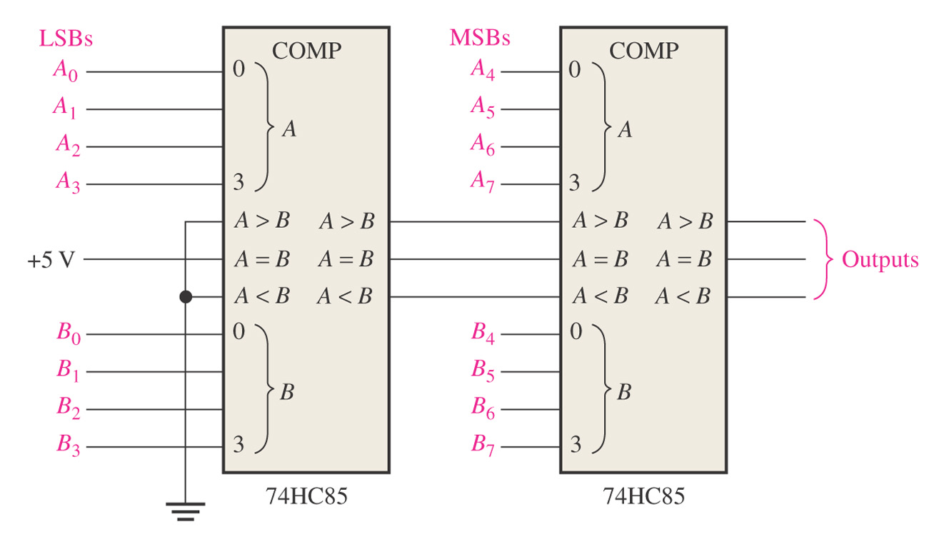
Figure 6–25 An 8-bit magnitude comparator using two 74HC85s.
Lowest-order comparator must have a LOW on A > B and A < B input and a HIGH on A = B input.

Slide 11
Decoders
Binary decoder
4-bit decoder
BCD-to-decimal decoder
BCD-to-7-segement decoder

Slide 12
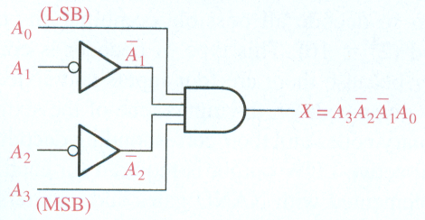
Decoders
Suppose we want to know when a binary 1001 occurs on the inputs of a digital circuit.
We can use a Decoder for this function.
Binary decoder
The output is 1 only when:
A₀ = 1
A₂ = 0
A₃ = 0
A₄ = 1
This is only one of an infinite number of examples

Slide 13
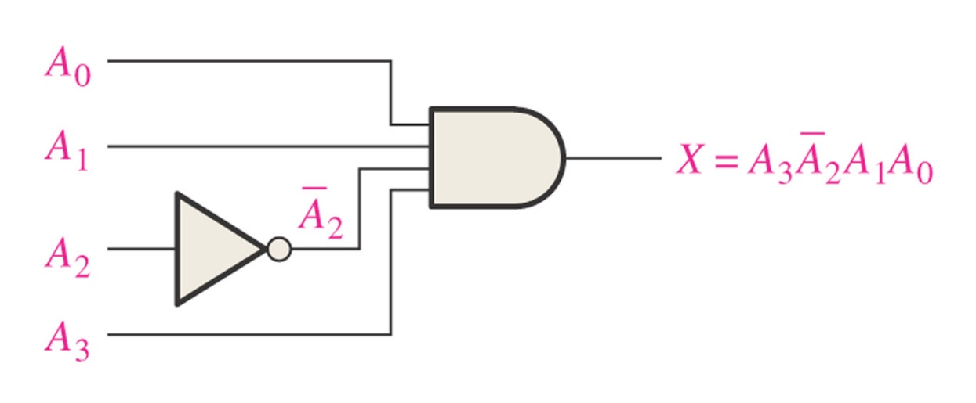
Determine the logic required to decode the binary number 1011 by producing a HIGH level on the output. LSB = A₀ (right most)
A₀ = 1, A₁ = 1, A₂ = 0, A₃ = 1
X = A₃A₂A₁A₀

Slide 14
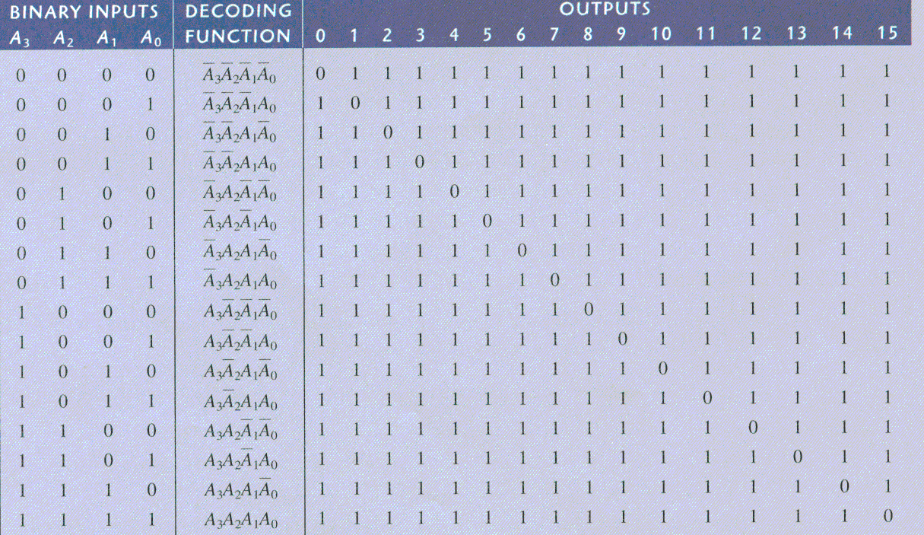
Decoders
4-bit decoder (4 line to 16 line decoder or 1 of 16 decoder)
Logic Diagram

Slide 15
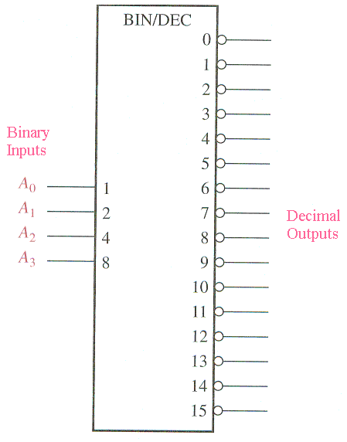
Decoders
4-bit decoder
Binary inputs
Active-low outputs (bubbles)
Truth Table
A₃A₂A₁A₀ Output 0 1 1 0 6 is low, all other outputs are high

Slide 16
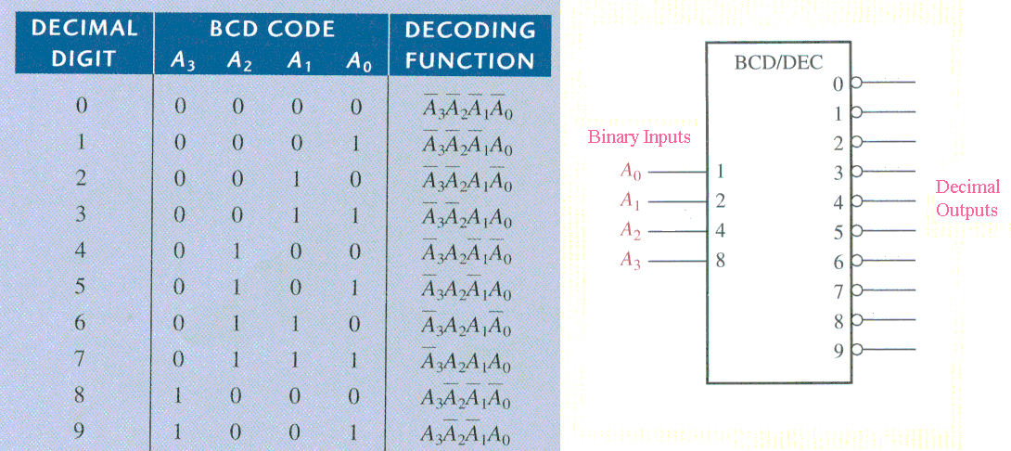
Decoders
BCD-to-decimal decoder
If 0011 is input, then output 3 is low and all other outputs are high Active Low output since bubbles on outputs.

Slide 17
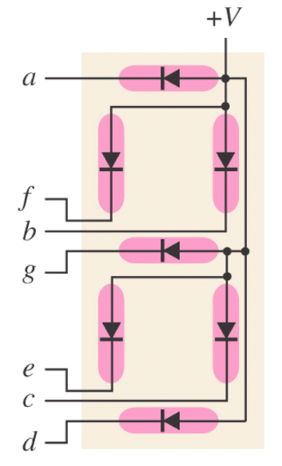
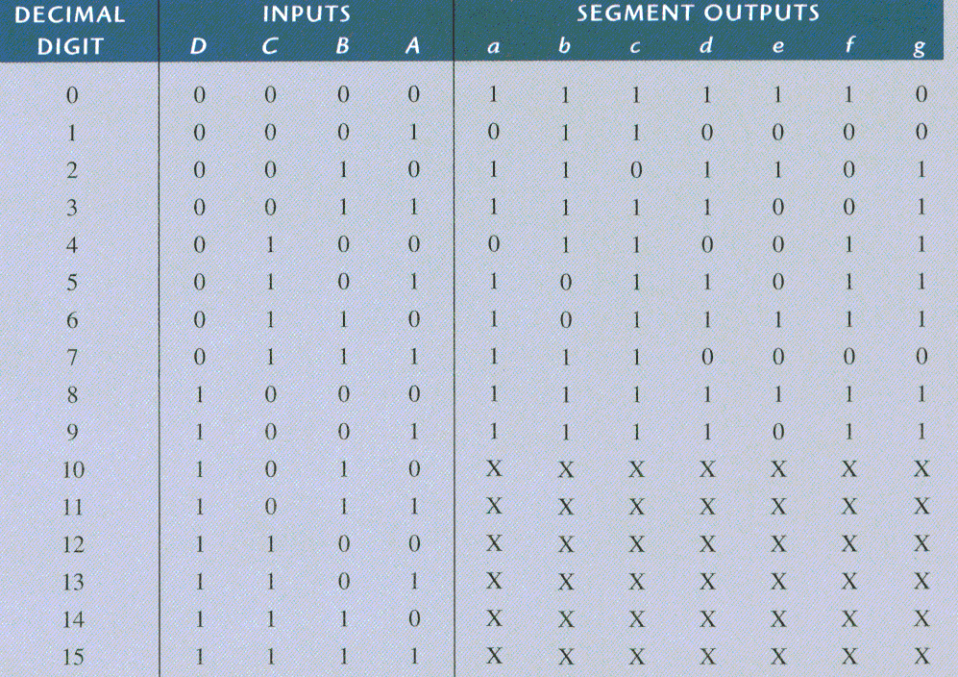
Decoders
BCD-to-7-segement decoder
Common-anode
Logic Diagram
Common Anode has all anodes of LEDs tied to +V

Slide 18
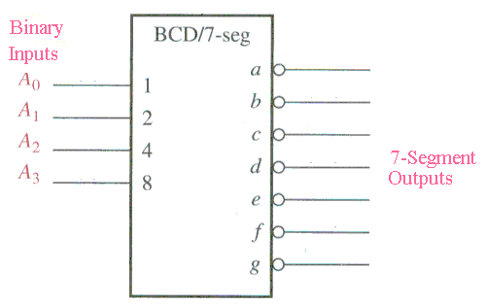
Decoders
BCD-to-7-segment decoder
Truth Table

Slide 19
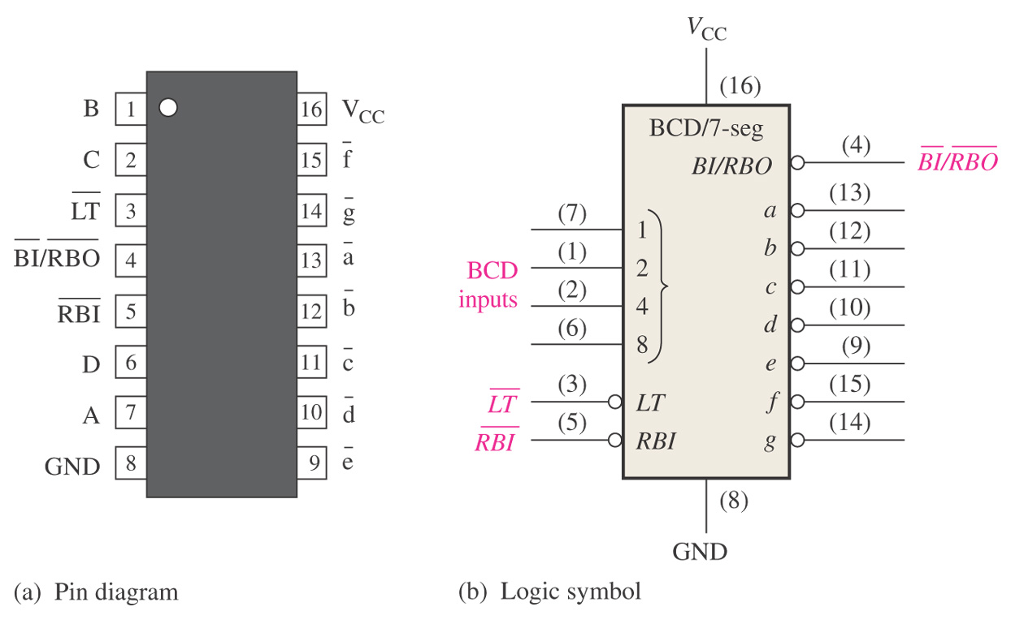
Figure 6–35 Pin diagram and logic symbol for the 74LS47 BCD-to-7-segment decoder/driver.
LT = Lamp Test - when LOW and BI/RBO is HI then all LEDs are ON BI = Blanking Input RBI = Ripple Blanking Input RBO = Ripple Blanking Output
Copyright ©2006 by Pearson Education, Inc. Upper Saddle River, New Jersey 07458 All rights reserved.

Slide 20
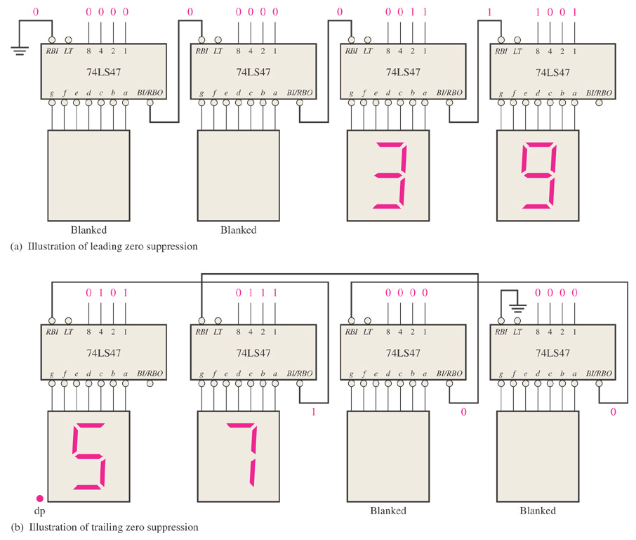
Figure 6–36 Examples of zero suppression using the 74LS47 BCD to 7-segment decoder/driver.
Tie RBI of Right to next left BI/RBO for leading zero suppression. Left most RBI is tied to ground.
Tie RBI of Left to next right BI/RBO for trailing zero suppression. Right most RBI is tied to ground.

Slide 21
Encoders
Decimal-to-BCD encoder
8-line-to-3-line encoder

Slide 22
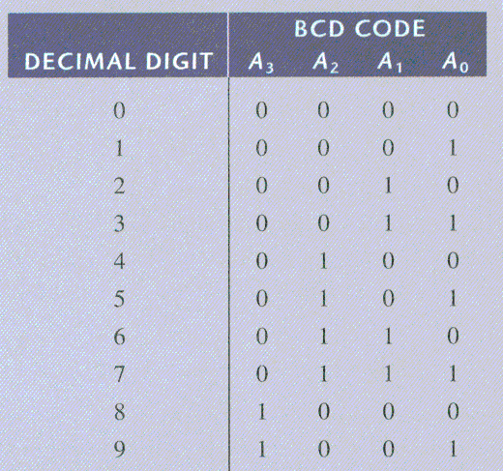
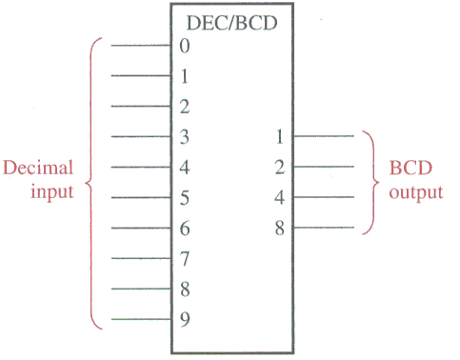
Encoders
Decimal-to-BCD encoder ( 10 inputs, 4 outputs)

Slide 23
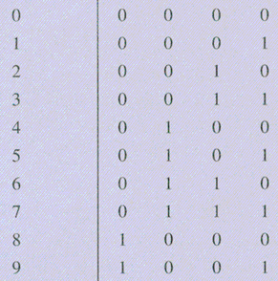
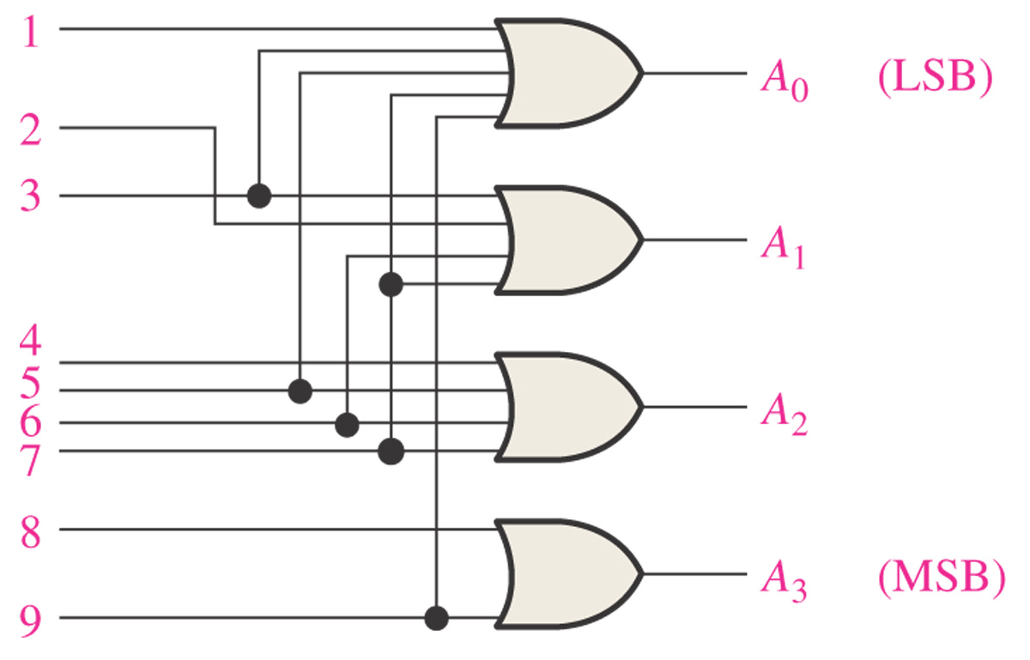
Logic Diagram of Decimal-to-BCD Encoder
All odds
A₀ = 1 + 3 + 5 + 7 + 9
A₁ = 2 + 3 + 6 + 7
A₂ = 4 + 5 + 6 + 7
A₃ = 8 + 9

Slide 24
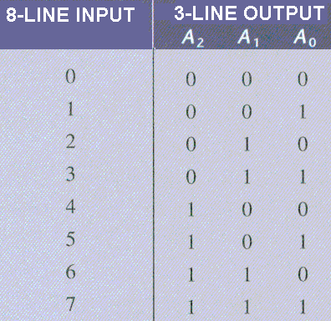
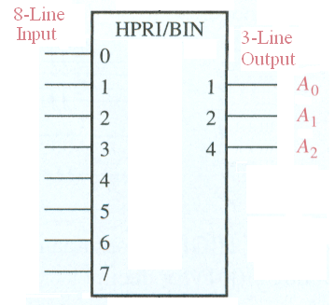
Encoders
8-line-to-3-line encoder
If line 5 on input is high, then output will be 101. Assume only one input is high.

Slide 25
Code Converters
BCD-to-binary conversion
Binary-Gray conversions

Slide 26
BCD
Convert BCD number 00100111 to binary.
Could convert to decimal 27 and then convert to binary.
Can add weights.
80 40 20 10 8 4 2 1 0 0 1 0 0 1 1 1 1 1 10 2 100 4
10100 20
0011011 27

Slide 27
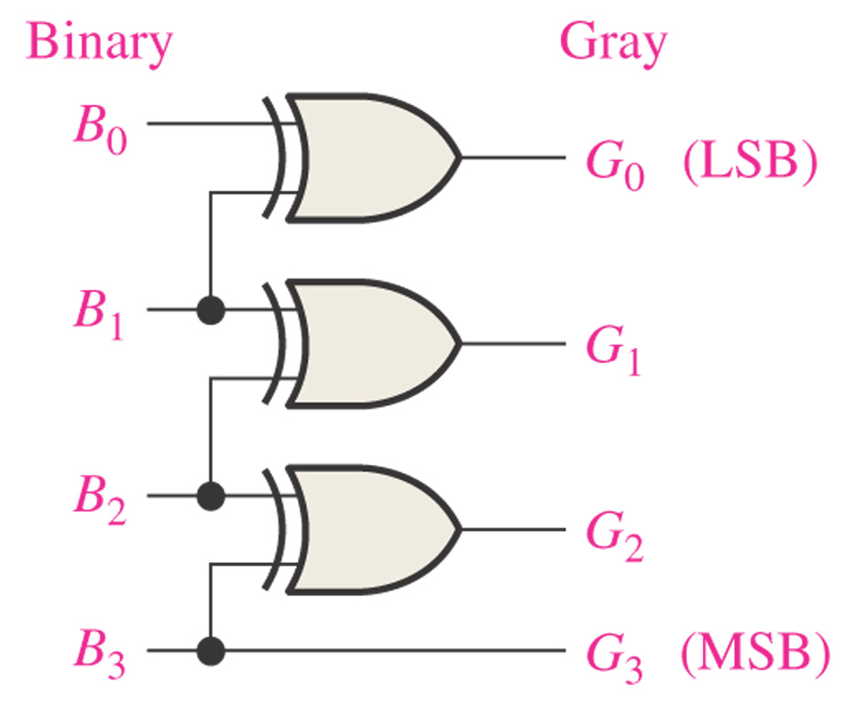
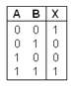
Figure 6–43 Four-bit binary-to-Gray conversion logic.
Convert 1 1 0 0 to Gray
1
0
1
0
XOR

Slide 28
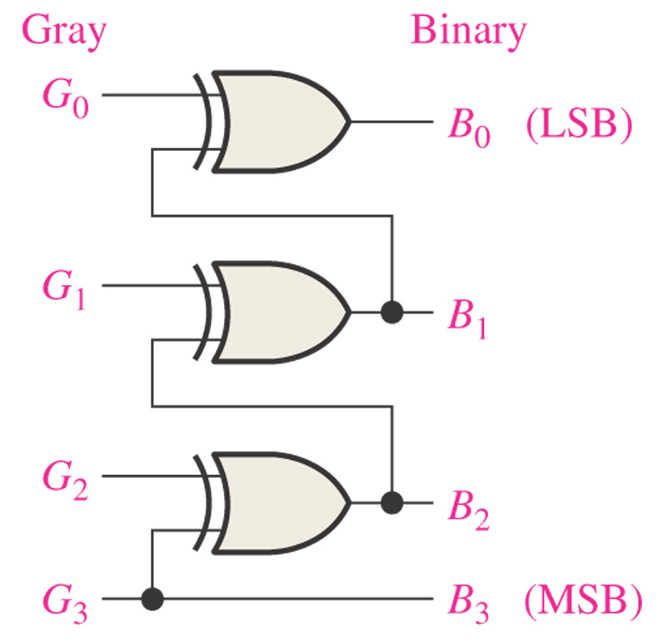
Figure 6–44 Four-bit Gray-to-binary conversion logic.
Convert 1 0 1 0 to Gray
1
1
0
0
XOR

Slide 29
Multiplexers (Data Selectors)
4-input multiplexer
Expanded multiplexers

Slide 30
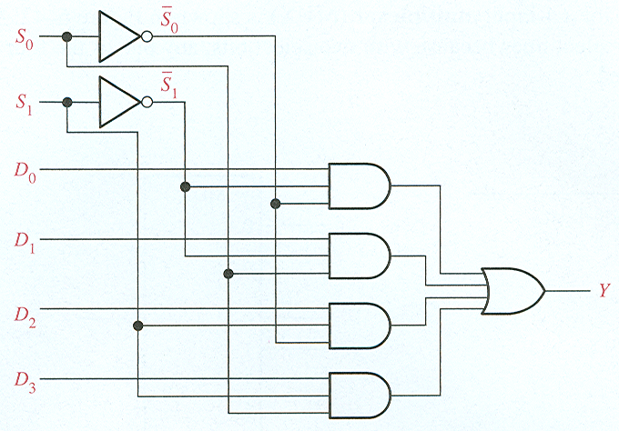
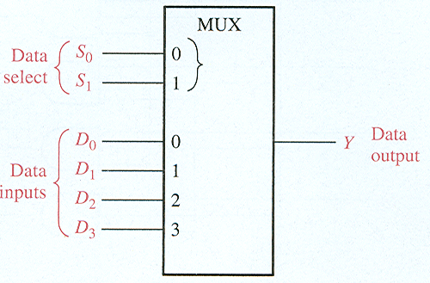
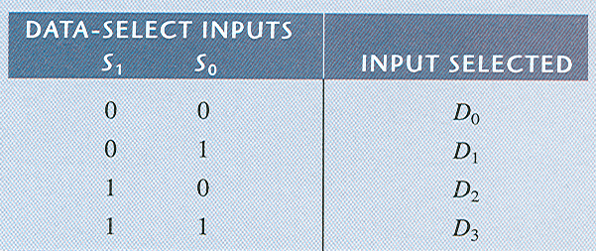
Multiplexers (Data Selectors)
4-input multiplexer
If Data-Select Inputs are 10, then Y = D₂ If D₂ = 0, then Y = 0. If D₂ = 1, then Y = 1.

Slide 31
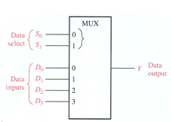
What is the output Y if we have the following inputs?
0 1
1 1
1 0 1 0
1 0 1 0
1
0

Slide 32
Demultiplexers
Reverses the multiplexing function.
Sends the data input to the selected output.
Decoders can be demultiplexers.

Slide 33
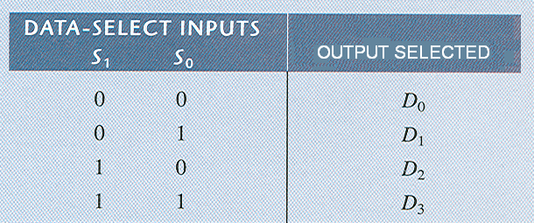
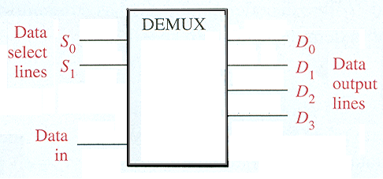
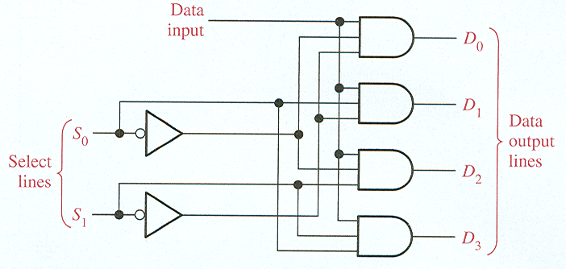
Demultiplexers
2-line-to-4-line demux

Slide 34
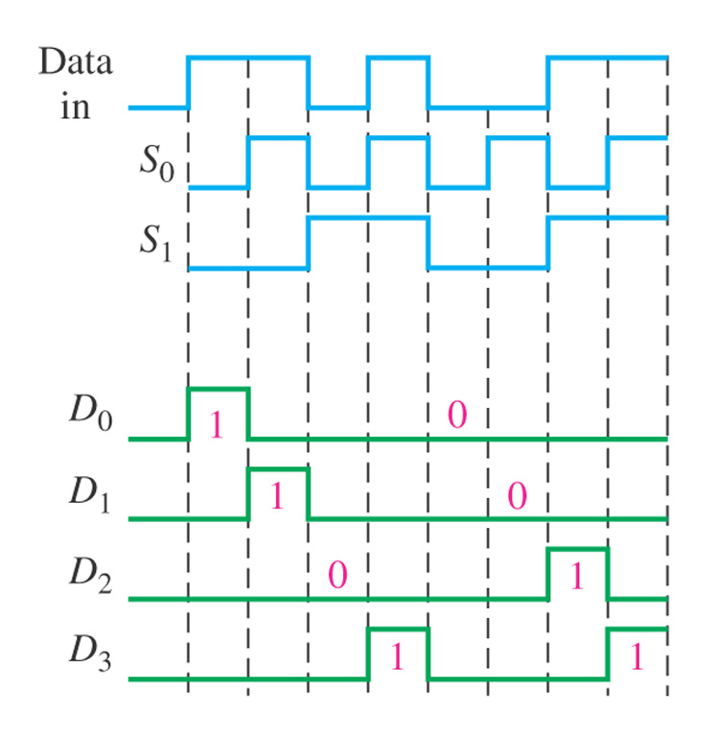
Find the data-output waveforms for the demultiplexer.
S₀ and S₁ select which output line will receive the input data.
If data input is zero, then all outputs will be zero.

Slide 35
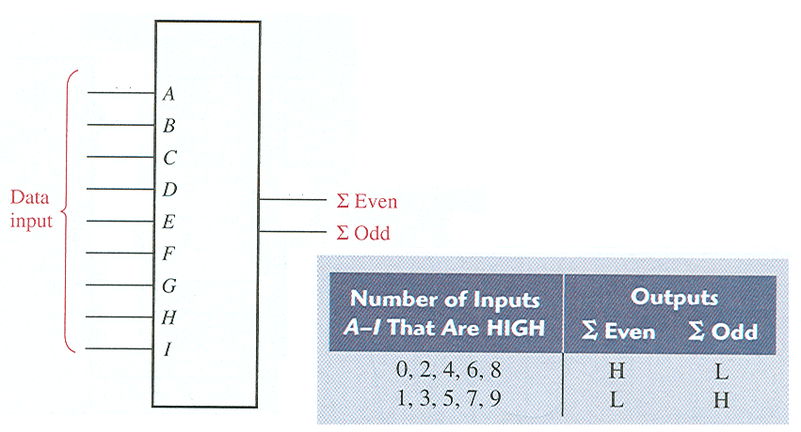
Parity Generators/Checkers
Parity generator/checker
Sum of even number of 1s is always 0. Sum of odd number of 1s is always 1.

Slide 36
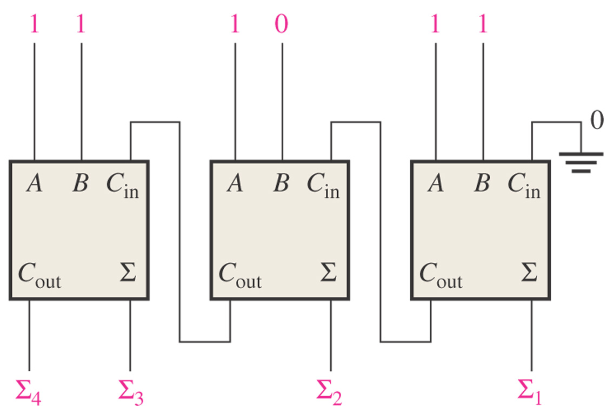
Figure 6–76. Problem 4. Find the sum based on the inputs. Note: We are adding A = 111 to B = 101.
1
1
0
0

Slide 37
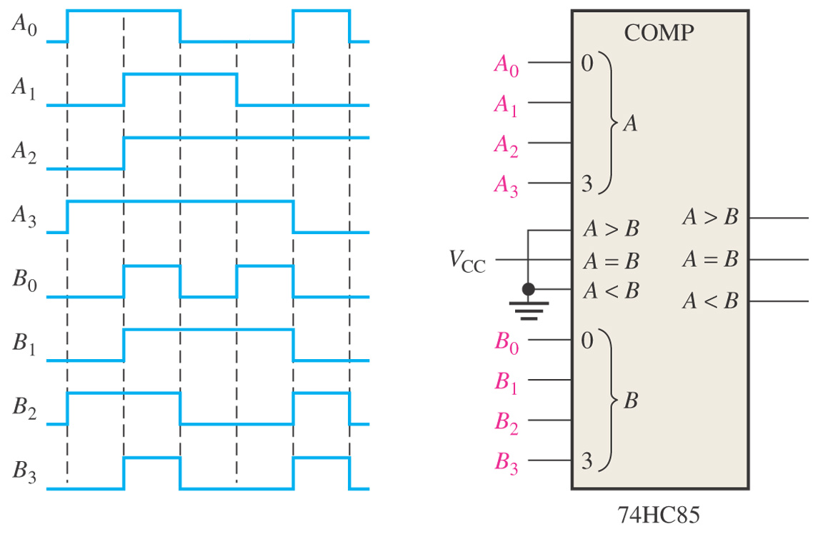
Figure 6–80 Problem 14. Plot the 3 outputs (A>B, A=B, A<B)
A₃A₂A₁A₀ B₃B₂B₁B₀ A>B A = B A<B 1 0 0 1 0 1 0 0 1 0 0 1 1 1 1 1 1 1 1 0 1 0 1 1 1 0 0 0 1 0 1 0 0 1 1 0 0 0 0 1 1 1 0 0 0 1 0 1 1 1 0 0 0 0 1
A>B
A=B
A<B

Slide 38
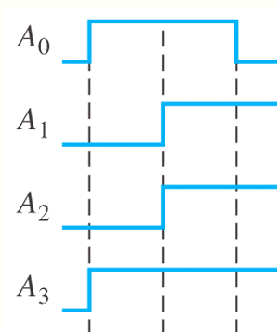
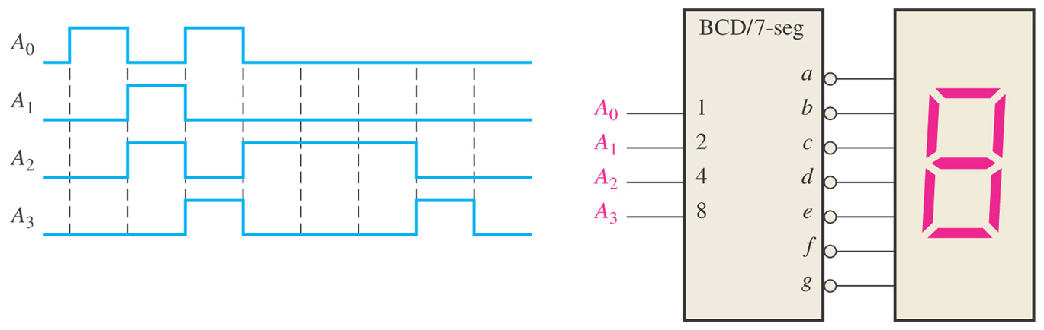
Figure 6–84. Problem 22. Find sequence of digits that appear.
3
2
1
A₃A₂A₁A₀ 0 0 0 0 0 1 0 0 1 9 1 1 1 1 undefined 0 1 1 1 7
0

Slide 39
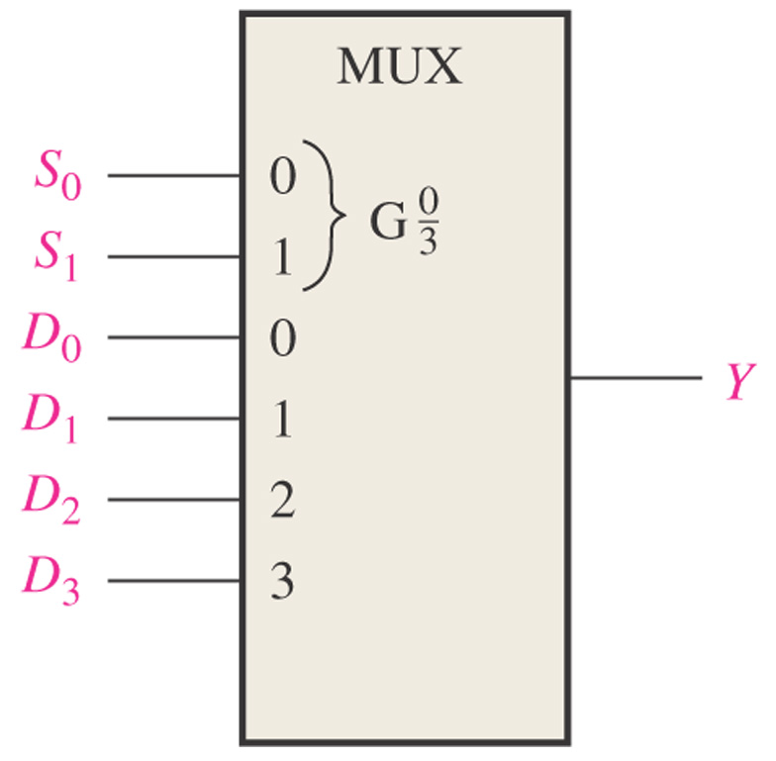
Figure 6–85. Like Problem 28.
If S₀S₁ = 11 and D₃D₂D₁D₀ = 1001, what is the output?
= 1

